Slide 1
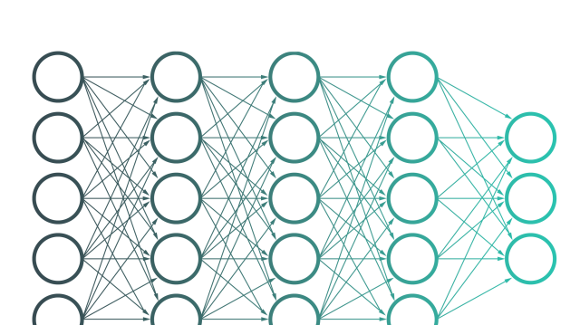
SEMANTIC SEGMENTATION
CAPSTONE PROJECT

Slide 2
01
02
03
04
05
06
PROBLEM
STATEMENT
WHAT IS SEMANTIC SEGMENTATION ?
UNDERSTANDING THE DATA
METHODOLOGY
UNET ARCHITECTURE, VGG AND RESNET
RESULT AND CONCLUSION

Slide 3
PROBLEM STATEMENT

Slide 4
PROBLEM STATEMENT
Create a semantic segmentation model using Tensorflow that determines the region of the disease looking at the 3D medical image provided. Only task to be done is colon cancer segmentation.
Utilize Transfer learning to train the model faster
Train and validate the model on 2D images (converted from 3D)
Demonstrate by inferencing on both 2D images and 3D images.
Keep the latency of the model (forward pass) less than 250ms on the GPU provided on Colab (Nvidia T4)
Use “nibabel” library available using pip for data preparation.

Slide 5
WHAT IS SEMANTIC SEGMENTATION ?

Slide 6
SEMANTIC SEGMENTATION
Definition: Semantic segmentation is a computer vision task that involves partitioning an image into multiple meaningful regions or segments.
Each pixel in the image is assigned a label corresponding to the category it belongs to.
Enables a detailed understanding of images by labeling each pixel individually.

Slide 7
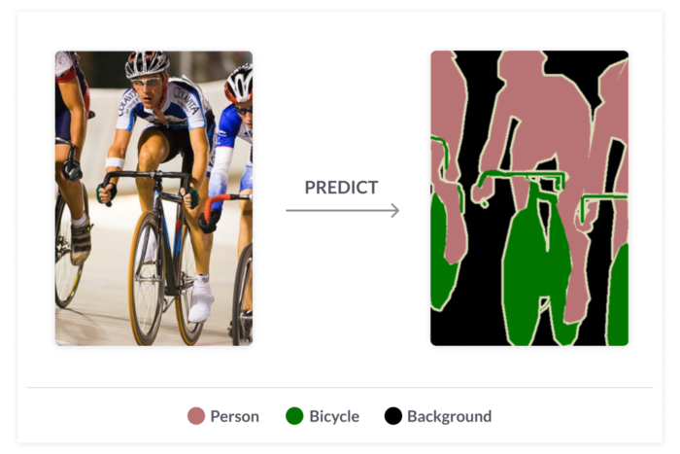
SEMANTIC SEGMENTATION
The following is an example of semantic segmentation

Slide 8
UNDERSTANDING
THE DATA

Slide 9
Understanding the data
The Data for this project is a collection of 3D Images of Colon.
These Images are taken from a CT scan Machine while detecting for the colon cancer.
The data contains Images of the colon as well as there corresponding label/mask showing the position of the cancer.
These Images of Colon are in NIFTI1 format, which are medical images which stores data in a standardized format known as Hounsfield value.
Next Slide We will see Some Example Images.

Slide 10
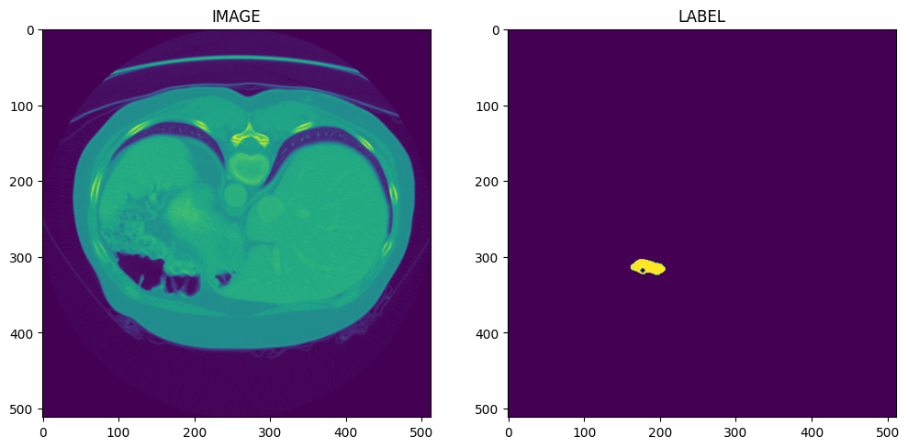
Understanding the data
The Following is an Example Images from our dataset
The Images in the Dataset are 3D images. The above shown image is a 2D slice of a Image and the label corresponding to it. The yellow spot in the label represents the cancer.

Slide 11
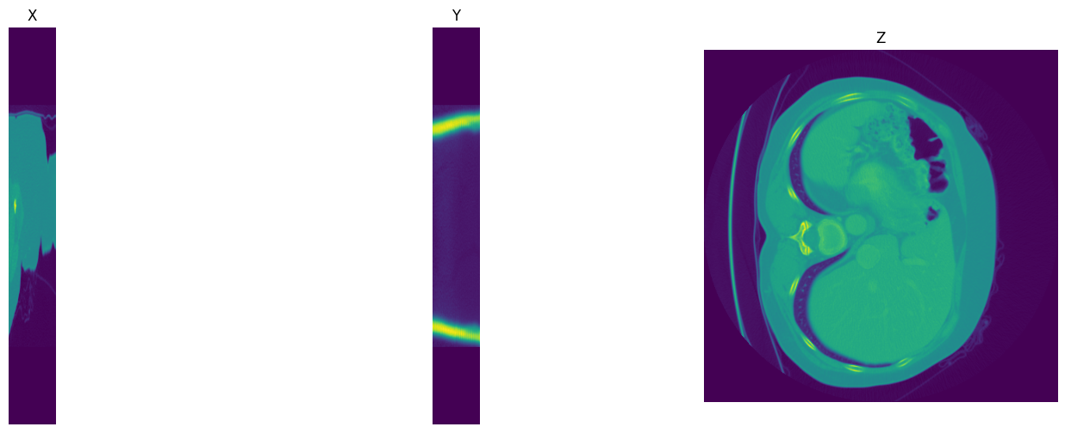
Understanding the data
Let us Take an Image Slice and see it in different dimension

Slide 12
Understanding the data
If we represent an Image as an array of numerical value then we get something like below
array([[[-1024., -1024., -1024., ..., -1024., -1024., -1024.], [-1024., -1024., -1024., ..., -1024., -1024., -1024.], [-1024., -1024., -1024., ..., -1024., -1024., -1024.], ..., [-1024., -1024., -1024., ..., -1024., -1024., -1024.], [-1024., -1024., -1024., ..., -1024., -1024., -1024.]]])
These values above are known as Hounsfield Values which we will discuss in the next slide

Slide 13
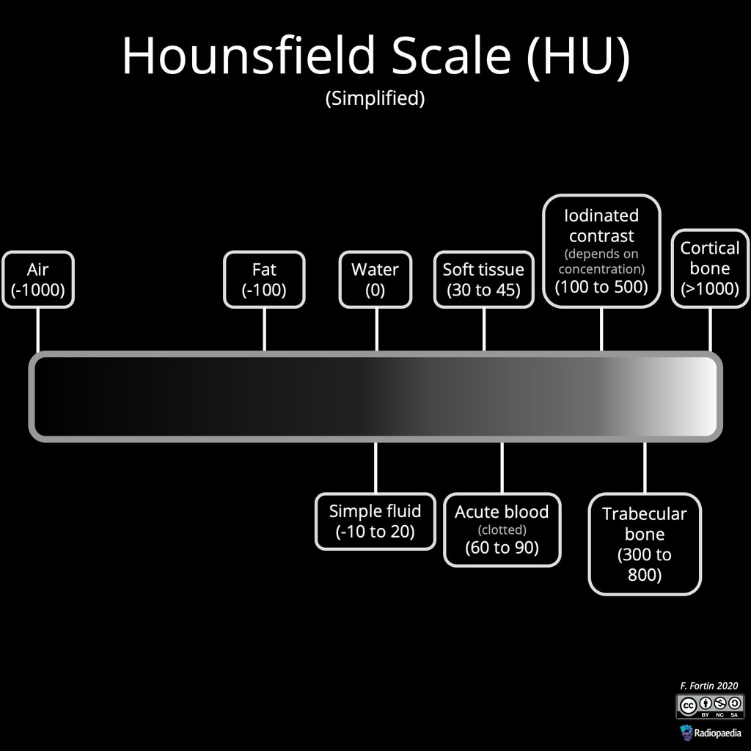
Understanding the data
HOUNSFIELD VALUES
Hounsfield value, also known as CT number, is a standardized way of quantifying the radio density of tissues. For CT scans, generally the value of HU ranges from -1024 to 3071, from least dense which is air to most dense which are bones. Water has a HU of 0.
The following shows a Hounsfield scale.

Slide 14
METHODOLOGY

Slide 15
METHODOLOGY
Step 1. Import all the required libraries
Step 2. Preprocess the images which includes Normalizing image values and then slicing the 3D images and storing the 2D slices as png.
Step 3. Load the new 2D images and prepare them for training our model.
Step 4. Preparing the UNet model using different backbones (ResNet and MobileNet)
Step 5. And lastly, Evaluate the model and perform Inference on the images.

Slide 16
UNET ARCHITECTURE

Slide 17
Unet architecture
U-Net is a popular convolutional neural network (CNN) architecture designed for biomedical image segmentation tasks.
The architecture is named after its U-shaped structure, which consists of a contracting path (left side) and an expanding path (right side).
CONTRACTING PATH
The contracting path captures the context and learns feature representations at different scales.
It consists of a series of convolutional layers followed by max-pooling operations to reduce spatial dimensions

Slide 18
Unet architecture
EXPANDING PATH
The expanding path recovers the spatial resolution and generates segmentation masks.
It consists of a series of upsampling and concatenation operations, followed by convolutional layers.
SKIP CONNECTIONS
Skip connections are used to combine the feature maps from the contracting path with the corresponding feature maps in the expanding path.
These connections help in preserving fine-grained details and aid in precise localization.

Slide 19
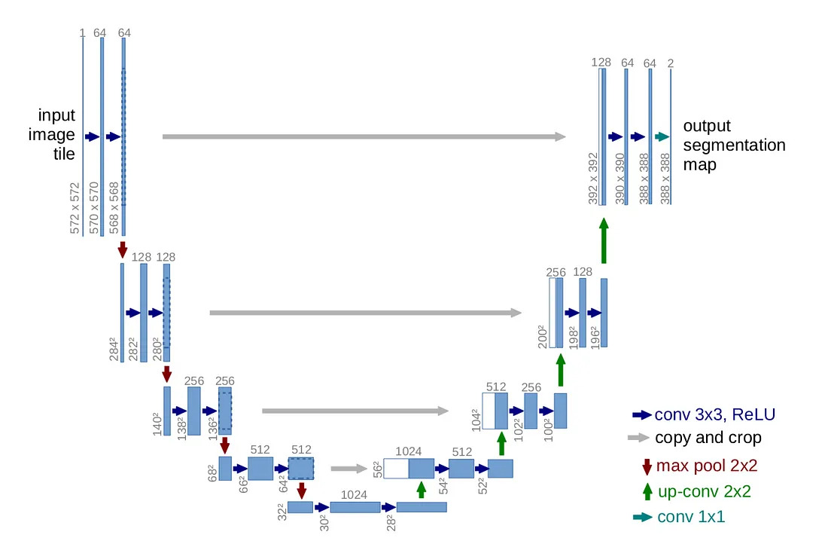
Unet architecture

Slide 20
Unet architecture
LOSS FUNCTION
The U-Net architecture is typically trained using a pixel-wise loss function such as the dice coefficient or Cross Entropy.
ADVANTAGES
U-Net has shown excellent performance in biomedical image segmentation due to its ability to capture both local and global context.
It can handle a limited amount of labeled training data effectively.
The skip connections enable precise segmentation and help overcome the limitations of vanishing gradients during training.

Slide 21
Unet architecture
BACKBONE
The backbone in Unet architecture is referred to it’s Encoder/Contracting Path.
Instead of using custom CNN model we can utilize Transfer learning and define the backbone of the Unet as Some Pretrained CNN models like ResNet, MobileNet, VGG etc.
In this Project we will be using ResNet 34 and MobileNetV2 as backbones of our network and the weights are Initialized to ImageNet weights.

Slide 22
Unet architecture
RESNET 34
Deep Architecture:
ResNet-34 consists of 34 layers, making it a relatively deep CNN architecture.
The network is designed to tackle the challenge of training deep neural networks without suffering from the degradation problem, where accuracy saturates or even starts to degrade as the network depth increases.
Shortcut Connections: Shortcut connections (skip connections) in ResNet-34 help alleviate the vanishing gradient problem by providing direct paths for information flow between earlier and later layers. These connections facilitate the training of deep networks.
Residual Blocks: The network utilizes residual blocks, which contain skip connections (identity shortcuts). These connections allow the network to learn residual mappings and enable easier training of deep networks.

Slide 23
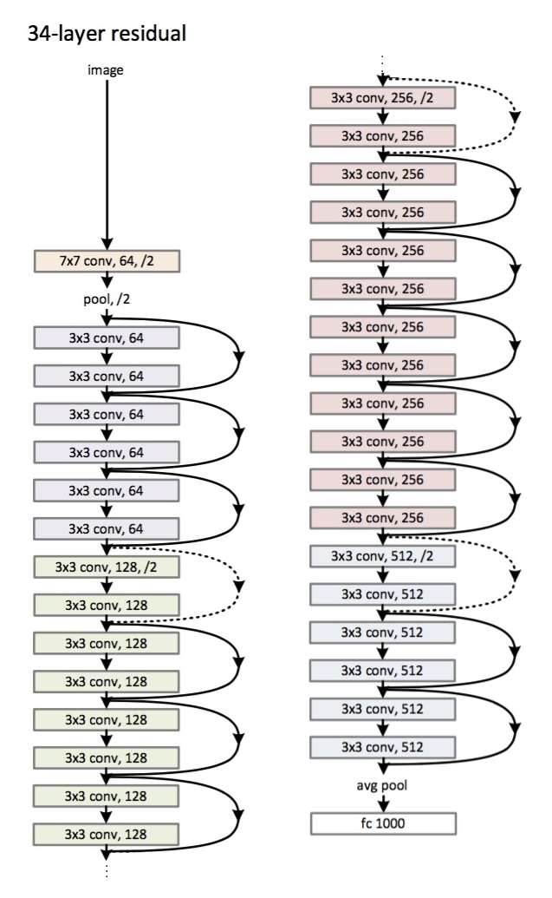
Unet architecture
RESNET 34 ARCHITECTURE

Slide 24
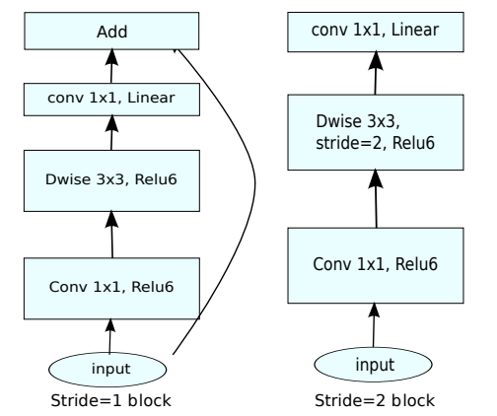
Unet architecture
MOBILENET V2
MobileNetV2 is an efficient convolutional neural network architecture designed for mobile and embedded vision applications. It builds upon the original MobileNet architecture and introduces improvements for better accuracy and efficiency.
Depthwise Separable Convolutions: The network splits convolutions into depthwise and pointwise convolutions, reducing the number of parameters and computational cost.
MobileNetV2 utilized two types of bottleneck blocks:

Slide 25
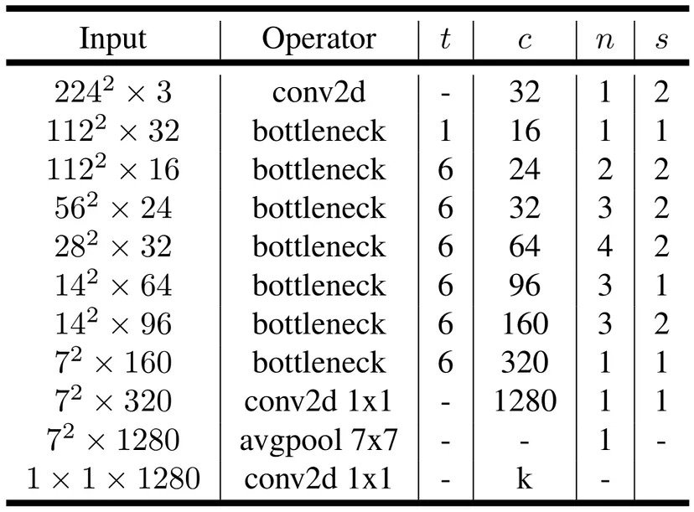
Unet architecture
MOBILENET V2 ARCHITECTURE

Slide 26
RESULT AND CONCLUSIONS

Slide 27
RESULTS AND CONCLUSIONS
METRICS FOR EVALUATION
The models in our project are evaluated on four metrics which are:
1. Accuracy
2. Intersection Over Union (IoU)
3. Dice Sorenson Coefficient (or F1 Score)
4. Precision
Accuracy : Accuracy measures the ratio of correctly predicted samples to the total number of samples and provides a straightforward measure of overall correctness. However, it may not be suitable for imbalanced datasets or when the costs of false positives and false negatives differ.
IOU : IoU calculates the overlap between predicted and true regions in object detection and image segmentation tasks. It ranges from 0 to 1, with higher values indicating better alignment.

Slide 28
RESULTS AND CONCLUSIONS
DICE COEFFICIENT : Dice coefficient measures the similarity between predicted and true segmentation masks. It ranges from 0 to 1, with 1 indicating a perfect match. Dice Coefficient is very similar to IoU, the only difference being that it is a lot more sensitive than IoU.
PRECISION : Precision focuses on the accuracy of positive predictions, measuring the proportion of correctly predicted positive samples out of all samples predicted as positive. It is useful when minimizing false positives is important.

Slide 29
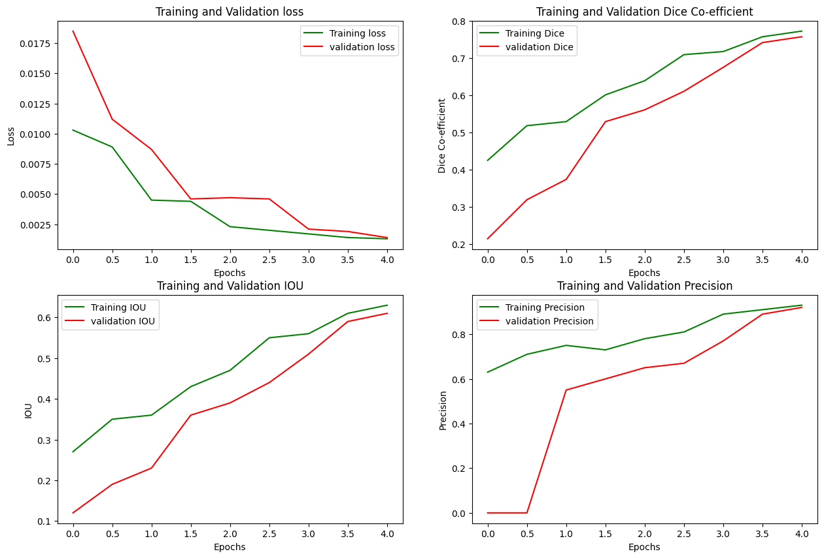
RESULTS AND CONCLUSIONS
GRAPH PLOTS FOR RESNET
Resnet Metrics
Accuracy – 95%
IoU – 0.66
Dice – 0.86
Precision – 0.89

Slide 30
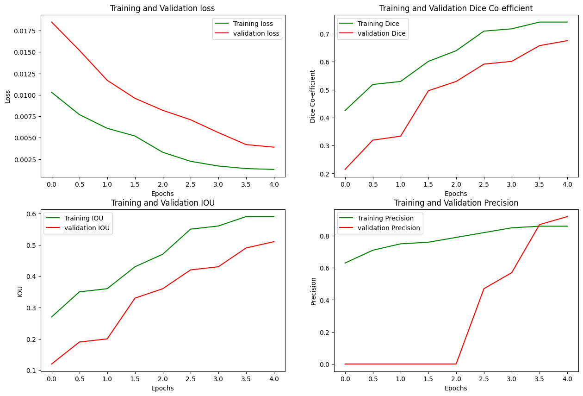
RESULTS AND CONCLUSIONS
GRAPH PLOTS FOR MOBILENET
MobileNet Metrics
Accuracy – 86%
IoU – 0.57
Dice – 0.76
Precision – 0.81

Slide 31
RESULTS AND CONCLUSIONS
INFERENCE TIME OF THE MODELS
 | RESNET | MOBILENET
MAXIMUM | 153 ms | 213 ms
MINIMUM | 68 ms | 63 ms
AVERAGE | 85 ms | 92 ms

Slide 32
RESULTS AND CONCLUSIONS
CONCLUSION
Performance : Individually both the models performed above average. Comparatively Resnet Outclassed Mobilenet in all the metric criteria.
Inference Time – Again Inference time of Resent was faster than mobilenet. Although the difference was not very significant
In both the models we did observe a low IoU, which is most probably due to the fact that we have a lots of negative examples as compared to the positive examples.

Slide 33
THANK YOU

